Slide 1
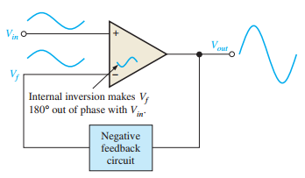
Negative feedback on op-amps
Negative feedback is one of the most useful concepts in electronics, particularly in op-amp applications.
Negative feedback is the process whereby a portion of the output voltage of an amplifier is returned to the input with a phase angle that opposes (or subtracts from) the input signal.
Negative feedback is illustrated in Figure 12–14. The inverting input effectively makes the feedback signal 180° out of phase with the input signal

Slide 2


Why Use Negative Feedback?
The inherent open-loop voltage gain of a typical op-amp is very high (usually greater than 100,000).
Therefore, an extremely small input voltage drives the op-amp into its saturated output states. In fact, even the input offset voltage of the op-amp can drive it into saturation. For example, assume VIN =1 mV and Aol =100,000.
Then,
Vo = VIN - Aol = 1 mV x100,000=100V
Since the output level of an op-amp can never reach 100 V, it is driven deep into saturation and the output is limited to its maximum output levels, as illustrated in Figure 12–15 for both a positive and a negative input voltage of 1 mV.
The usefulness of an op-amp operated without negative feedback is generally limited to comparator applications.

Slide 3
OP-AMPS WITH NEGATIVE FEEDBACK
An op-amp can be connected using negative feedback to stabilize the gain and increase frequency response.
Negative feedback takes a portion of the output and applies it back out of phase with the input, creating an effective reduction in gain.
This closed loop gain is usually much less than the open-loop gain and independent of it .
Closed-Loop Voltage Gain, Acl
The closed-loop voltage gain is the voltage gain of an op-amp with external feedback.
The amplifier configuration consists of the op-amp and an external negative feedback circuit that connects the output to the inverting input.

Slide 4
The closed-loop voltage gain is determined by the external component values and can be precisely controlled by them.
Noninverting Amplifier
An op-amp connected in a closed-loop configuration as a noninverting amplifier with a controlled amount of voltage gain is shown in Figure 12–16. The input signal is applied to the noninverting (+) input. The output is applied back to the inverting input through the feedback circuit (closed loop) formed by the input resistor Ri and the feedback resistor Rf.

Slide 5

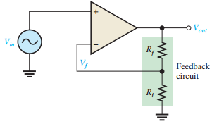
This creates negative feedback as follows.
Resistors Ri and Rf form a voltage-divider circuit, which reduces Vout and connects the reduced voltage Vf to the inverting input. The feedback voltage is expressed as
Figure 12.16 Noninverting amplifier.

Slide 6
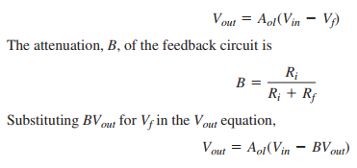
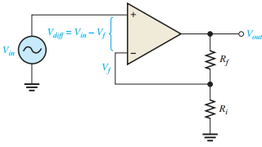
The difference of the input voltage, Vin, and the feedback voltage, Vf, is the differential input to the op-amp, as shown in Figure 12–17. This differential voltage is amplified by the open-loop voltage gain of the op-amp (Aol) and produces an output voltage expressed as
                Figure 12.17 Differential input, vin - Vf

Slide 7
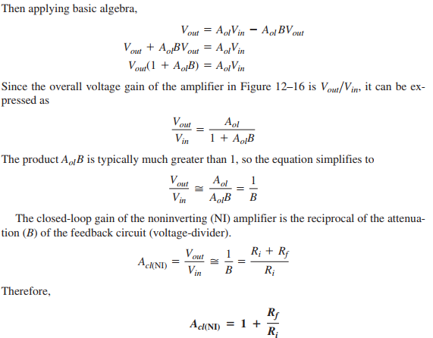

Slide 8
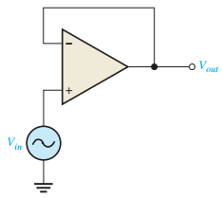
Notice that the closed-loop voltage gain is not at all dependent on the op-amp’s open-loop voltage gain under the condition.
The closed-loop gain can be set by selecting values of Ri and Rf
Voltage-Follower
The voltage-follower configuration is a special case of the noninverting amplifier where all of the output voltage is fed back to the inverting input by a straight connection, as shown in Figure 12–19. As you can see, the straight feedback connection has a voltage gain of 1 (which means there is no gain). The closed-loop voltage gain of a noninverting amplifier is as previously derived. Since B =1 for a voltage-follower, the closed-loop voltage gain of the voltage-follower is

Slide 9
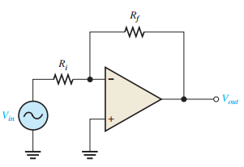
The most important features of the voltage-follower configuration are
its very high input impedance and
its very low output impedance.
Inverting Amplifier
An op-amp connected as an inverting amplifier with a controlled amount of voltage gain is shown in Figure 12–20. The input signal is applied through a series input resistor Ri to the inverting input. Also, the output is fed back through Rf to the same input. The noninverting (+) input is grounded.

Slide 10
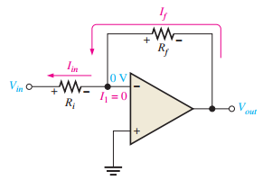
Note;
An infinite input impedance implies zero current at the inverting input. If there is zero current through the input impedance, then there must be no voltage drop between the inverting and noninverting inputs.
Thus, the voltage at the inverting input is zero because the noninverting (+) input is grounded.
This zero voltage at the inverting input terminal is referred to as virtual ground.
Since there is no current at the inverting input, the current through Ri and the current through Rf are equal, as shown in Figure 12–21(b).

Slide 11
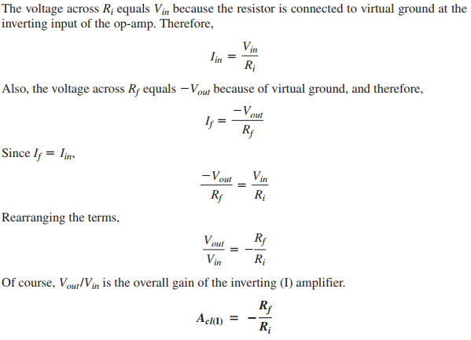

Slide 12
Note;
The closed loop gain is independent of the op-amp’s internal open-loop gain.
Thus, the negative feedback stabilizes the voltage gain.
(The negative sign indicates inversion).
Effects of negative feedback on op-amp impedances
Negative feedback affects the input and output impedances of an op-amp.
Impedances of the Noninverting Amplifier
Input Impedance
The input impedance of a noninverting amplifier can be developed with the aid of Figure 12–23. For this analysis, assume a small differential voltage, Vd, exists between the two inputs, as indicated.
This means that you cannot assume the op-amp’s input impedance to be infinite or the input current to be zero.

Slide 13
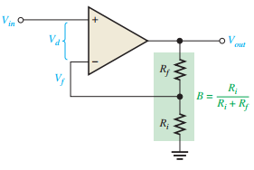
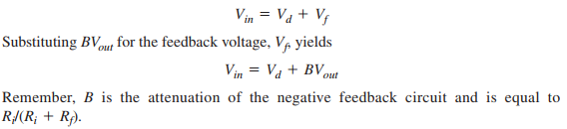
Express the input voltage as

Slide 14
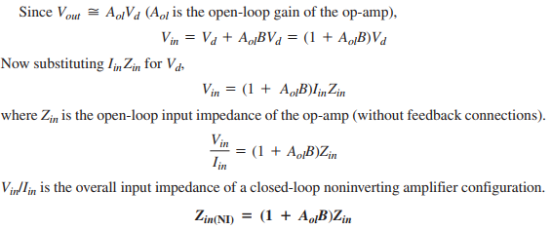
This equation shows that the input impedance of the noninverting amplifier configuration with negative feedback is much greater than the internal input impedance of the op-amp itself (without feedback).

Slide 15
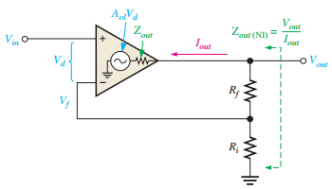
Output Impedance
An expression for output impedance of a noninverting amplifier can be developed with the aid of Figure 12–24.

Slide 16
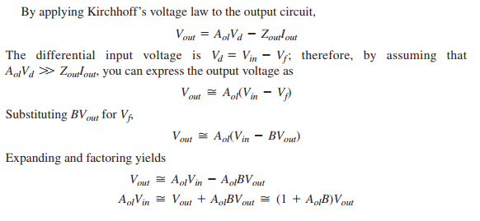

Slide 17
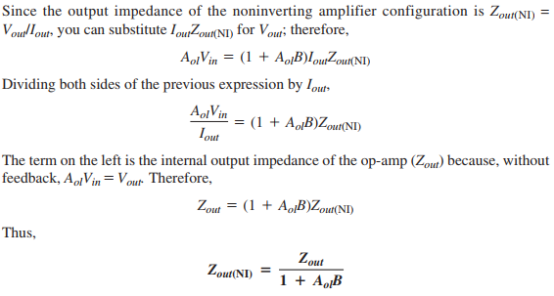

Slide 18
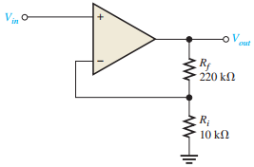
This equation shows that the output impedance of the noninverting amplifier configuration with negative feedback is much less than the internal output impedance, Zout, of the opamp itself (without feedback) because Zout is divided by the factor 1 + AolB.
Example
(a) Determine the input and output impedances of the amplifier in Figure 12–25. The op-amp datasheet gives Zin = 2 MΩ, Zout = 75Ω, and Aol = 200,000.
(b) Find the closed-loop voltage gain.

Slide 19
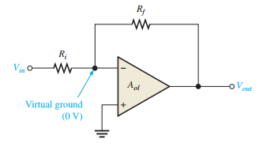

Impedances of the Inverting Amplifier
The input and output impedances of an inverting op-amp configuration are developed with the aid of Figure 12–26. Both the input signal and the negative feedback are applied, through resistors, to the inverting terminal as shown.
Input Impedance
The input impedance for an inverting amplifier is
This is because the inverting input of the op-amp is at virtual ground (0 V), and the input source simply sees Ri to ground, as shown in Figure 12–27.

Slide 20


Output Impedance
As with a noninverting amplifier, the output impedance of an inverting amplifier is decreased by the negative feedback. In fact, the expression is the same as for the noninverting case.
The output impedance of both the noninverting and the inverting amplifier configurations is very low; in fact, it is almost zero in practical cases.

Slide 21
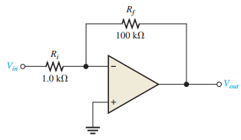
Because of this near zero output impedance, any load impedance within limits can be connected to the op-amp output and not change the output voltage. The limits for the load impedance are determined by the maximum peak-to-peak swing of the output voltage and the current limit of the op-amp.
Example;
Find the values of the input and output impedances in Figure 12–28. Also, determine the closed-loop voltage gain. The op-amp has the following parameters: Zin = 4 MΩ; and Zout = 50 Ω. Aol = 50,000;

Slide 22
Bandwidth of an OP-Amp
All electronic devices work only over a limited range of frequencies. This range of frequencies is called bandwidth.
Every OP-amp has a bandwidth i.e., the range of frequencies over which it will work properly. The bandwidth of an OP-amp depends upon the closed-loop gain of the OP-amp circuit. One important parameter is gain-bandwidth product (GBW).
It is defined as under :
ACL × f2 = funity = GBW
where
ACL = closed-loop gain at frequency f2
funity = frequency at which the closed-loop gain is unity

Slide 23
It can be proved that the gain-bandwidth product of an OP-amp is constant. Since an OP-amp is capable of operating as a d.c. amplifier, its bandwidth is (f2 – 0).
The gain-bandwidth product of an OP-amp is an important parameter because it can be used to find :
(i) The maximum value of ACL at a given value of f2.
(ii) The value of f2 for a given value of ACL.
Example;
An OP-amp has a gain-bandwidth product of 15 MHz. Determine the
bandwidth of OP-amp when ACL = 500. Also find the maximum value of ACL when f2 = 200 kHz.

Slide 24
Slew Rate
The slew rate of an OP-amp is a measure of how fast the output voltage can change and is measured in volts per microsecond (V/µs).
If the slew rate of an OP-amp is 0.5V/µs, it means that the output from the amplifier can change by 0.5 V every μs.
Since frequency is a function of time, the slew rate can be used to determine the maximum operating frequency of the OP-amp as follows:
Maximum operating frequency, fmax = Slew rate /2πVpk
Here Vpk is the peak output voltage.
Example;
1. Determine the maximum operating frequency for the circuit shown in Fig.
25.44. The slew rate is 0.5 V/µs

Slide 25
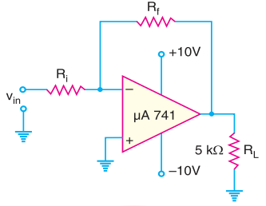
Figure 25.44
2.The amplifier in Fig. 25.44 is being used to amplify an input signal to a peak output voltage of 100 mV. What is the maximum operating frequency of the amplifier?
Note; The above examples show that an OP-amp can be operated at a much higher frequency when being used as a small-signal amplifier than when being used as a large-signal amplifier

Slide 26
Frequency Response of an OP-Amp
The operating frequency has a significant effect on the operation of an OP-amp. The following are the important points regarding the frequency response of an OP-amp :
(i) The maximum operating frequency of an OP-amp is given by;
fmax = Slew rate /2πVpk
Thus, the peak output voltage limits the maximum operating frequency.
(ii) When the maximum operating frequency of an OP-amp is exceeded, the result is a
distorted output waveform.
(iii) Increasing the operating frequency of an OP-amp beyond a certain point will :
(a) Decrease the maximum output voltage swing.
(b) Decrease the open-loop voltage gain.
(c) Decrease the input impedance.
(d) Increase the output impedance

Slide 27
Finally;
Identify the applications of op-amps

